Slide 1

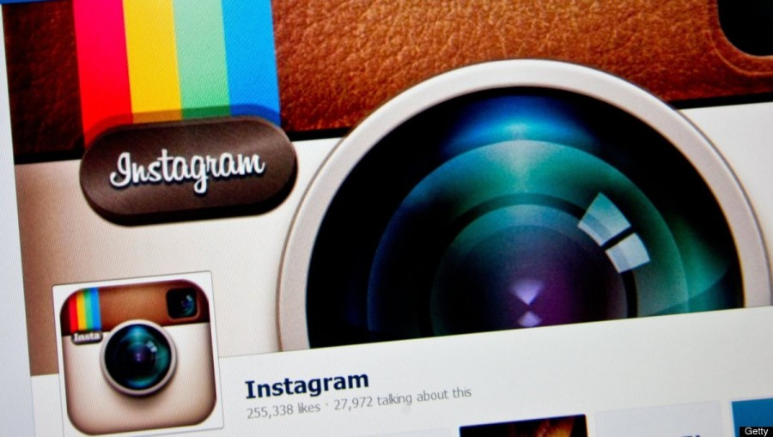
Instagram User Analytics
-Indu Prakash
This Photo by Unknown Author is licensed under CC BY-SA-NC

Slide 2
Project Description
The purpose of this project is to analyze user interactions and engagement with the Instagram app in order to provide valuable insights that can guide the business's growth strategy.
The insights derived from this analysis will be crucial for various teams within the business, such as marketing, product, and development, to make informed decisions and enhance the app's user experience.

Slide 3
Tech-Stack Used
MySQL Workbench 8.0 CE: MySQL Workbench is a visual database design tool and SQL development environment. It provides an intuitive interface for designing, modeling, and interacting with databases.
SQL (Structured Query Language): SQL is the language used for managing and querying relational databases. It was the primary language used to interact with the Instagram database.

Slide 4
A) Marketing Analysis

Slide 5
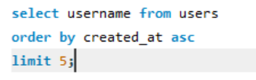
1.Loyal User Reward
Identify the five oldest users on Instagram from the provided database.

Slide 6
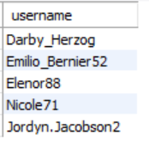
Five oldest users on Instagram

Slide 7
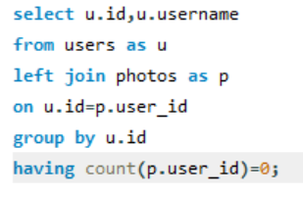
2.Inactive User Engagement
Identify users who have never posted a single photo on Instagram.

Slide 8
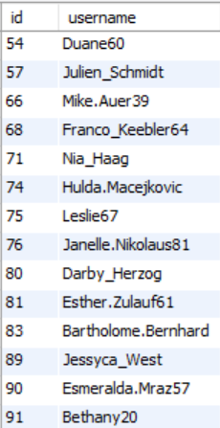
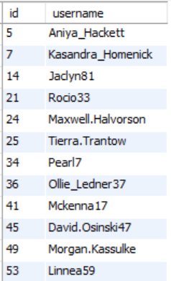
Users who have never posted

Slide 9
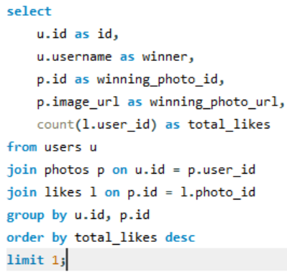
3.Contest Winner Declaration
Determine the winner of the contest and provide their details to the team.

Slide 10
The winner of the contest

Slide 11
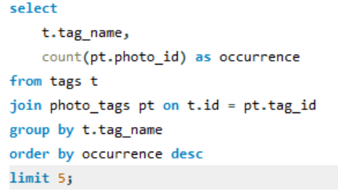
4.Hashtag Research
Identify and suggest the top five most commonly used hashtags on the platform.

Slide 12
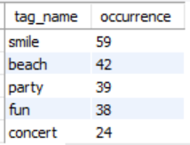
Top five mostly used hashtags

Slide 13
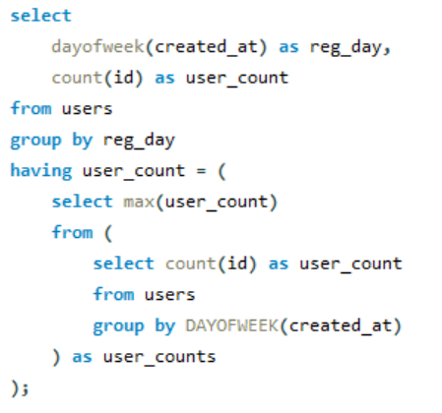
5.Ad Campaign Launch
Determine the day of the week when most users register on Instagram. Provide insights on when to schedule an ad campaign.

Slide 14

The days of the week when most users register
Thursday
Sunday

Slide 15
B) Investor Metrics:

Slide 16
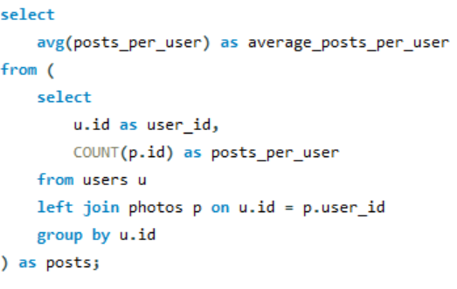

1.User Engagement
Calculate the average number of posts per user on Instagram. Also, provide the total number of photos on Instagram divided by the total number of users.

Slide 17


The average number of posts per user on Instagram
Total number of photos on Instagram divided by the total number of users

Slide 18
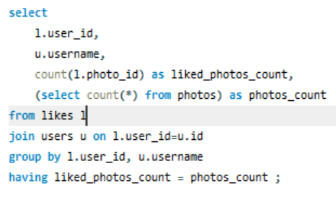
2.Bots & Fake Accounts
Identify users (potential bots) who have liked every single photo on the site, as this is not typically possible for a normal user.

Slide 19
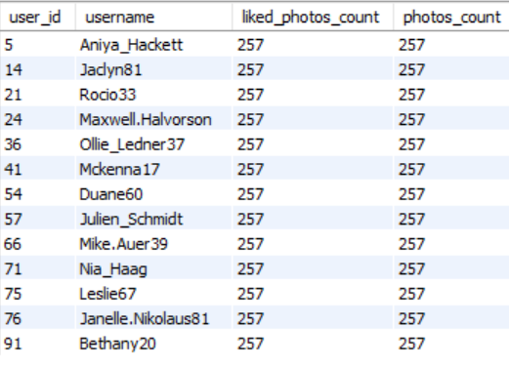
Bots & Fake Accounts

